Slide 1

Human Resource Management System (HRMS)
Dhruvkumar Mulani – 231040011006
Naman Singh - 231040012009
Shyam Chopda - 231040011028

Slide 2
Project Overview & Objective
Eliminate manual errors, reduce paperwork, improve efficiency
Real-time insights for HR, Managers & Employees
Self-service portal + Role-based access
Built for scalability, security, and compliance
Unified web-based HRMS to automate and streamline HR processes

Slide 3
Problem Statement
Fragmented HR operations using spreadsheets & legacy tools
High manual effort in attendance, leave, payroll & recruitment
Lack of real-time visibility and employee self-service
Risk of data inconsistency, security breaches, and non-compliance

Slide 4
Key Stakeholders & Use Cases
Stakeholder
Key Needs
HR/Admin Centralized data, payroll automation, reports
Employees Self-service: leave, payslip, profile update
Managers Approve requests, team performance tracking
Leadership Analytics, compliance, audit-ready data

Slide 5
Core Features (6 Modules)
Employee Management
Leave Management (with balance validation)
Attendance Tracking (timestamped logs)
Payroll Processing (auto-calculation + payslip)
Recruitment Pipeline
Performance Management (KRA + 360° feedback)

Slide 6
Technology Stack (Consistent)
Frontend: React.js (Responsive Web + PWA)
Backend: Node.js + Cloud Functions
Database: PostgreSQL (Primary) + Redis (Caching)
Authentication: JWT + Optional 2FA
File Storage: Google Cloud Storage (secure URLs)
Hosting: Google Cloud Platform (Scalable & Secure)
Real-time: WebSocket / Server-Sent Events where needed

Slide 7
System Architecture – Hybrid CAP Theorem Approach
Module
Choice
Reason
Payroll & Salary
CP
100% accuracy, no double payments
Employee Core Data
CP
Legal & audit compliance
Leave/Attendance View
Real-time not critical
AP
Announcements/Search
AP
Availability > Consistency
Notes:
Required

Slide 8
Security & Access Control
Role-Based Access Control (RBAC)
Admin/HR → Full access
Manager → Team-only access
Employee → Self-only access
Optional 2FA (TOTP)
Sensitive files: Time-limited signed URLs
Audit logs for all critical actions

Slide 9
Effort Estimation Using COCOMO Model
Team Size: 3 student developers
Time Period: 2 months (≈ 8 weeks)
Avg. Student Productivity: ~250 LOC per person per week
Calculations
LOC per week (team)
developers × 250 LOC = 750 LOC/week
Convert to KLOC
6000 LOC = 6 KLOC

Slide 10
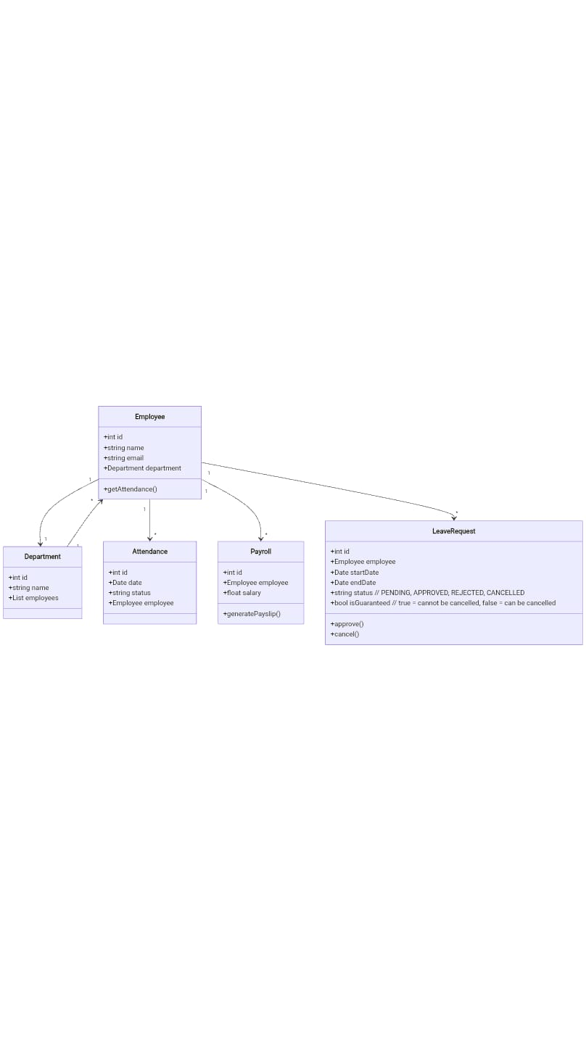
Logical View

Slide 11
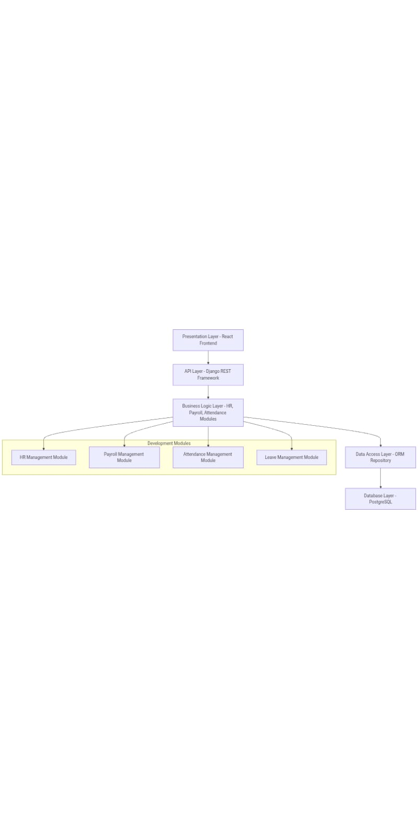
Devlopment View

Slide 12
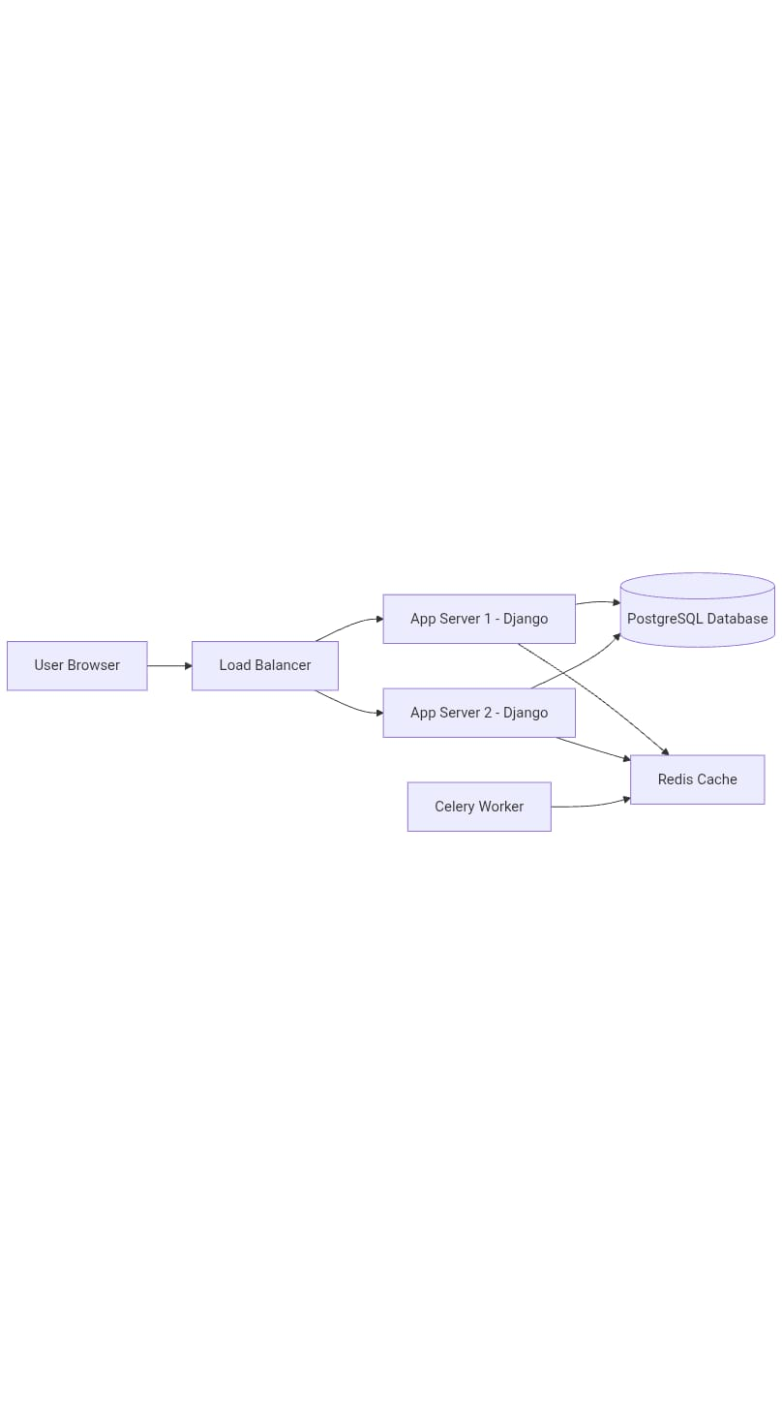
Physical View

Slide 13
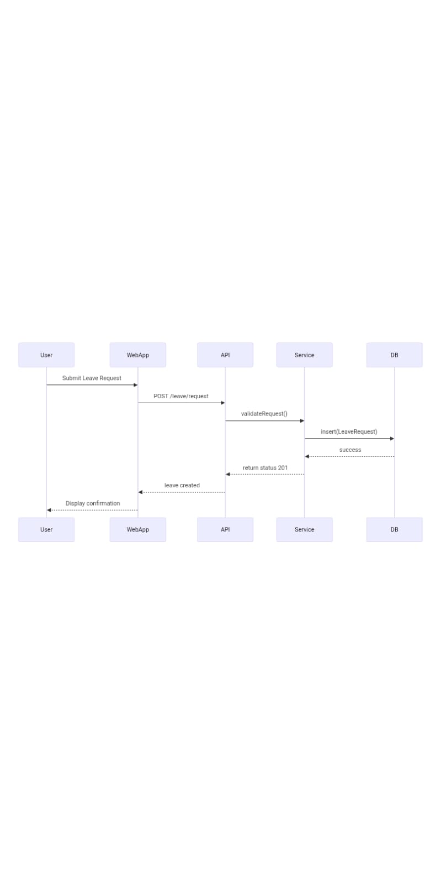
Process View

Slide 14
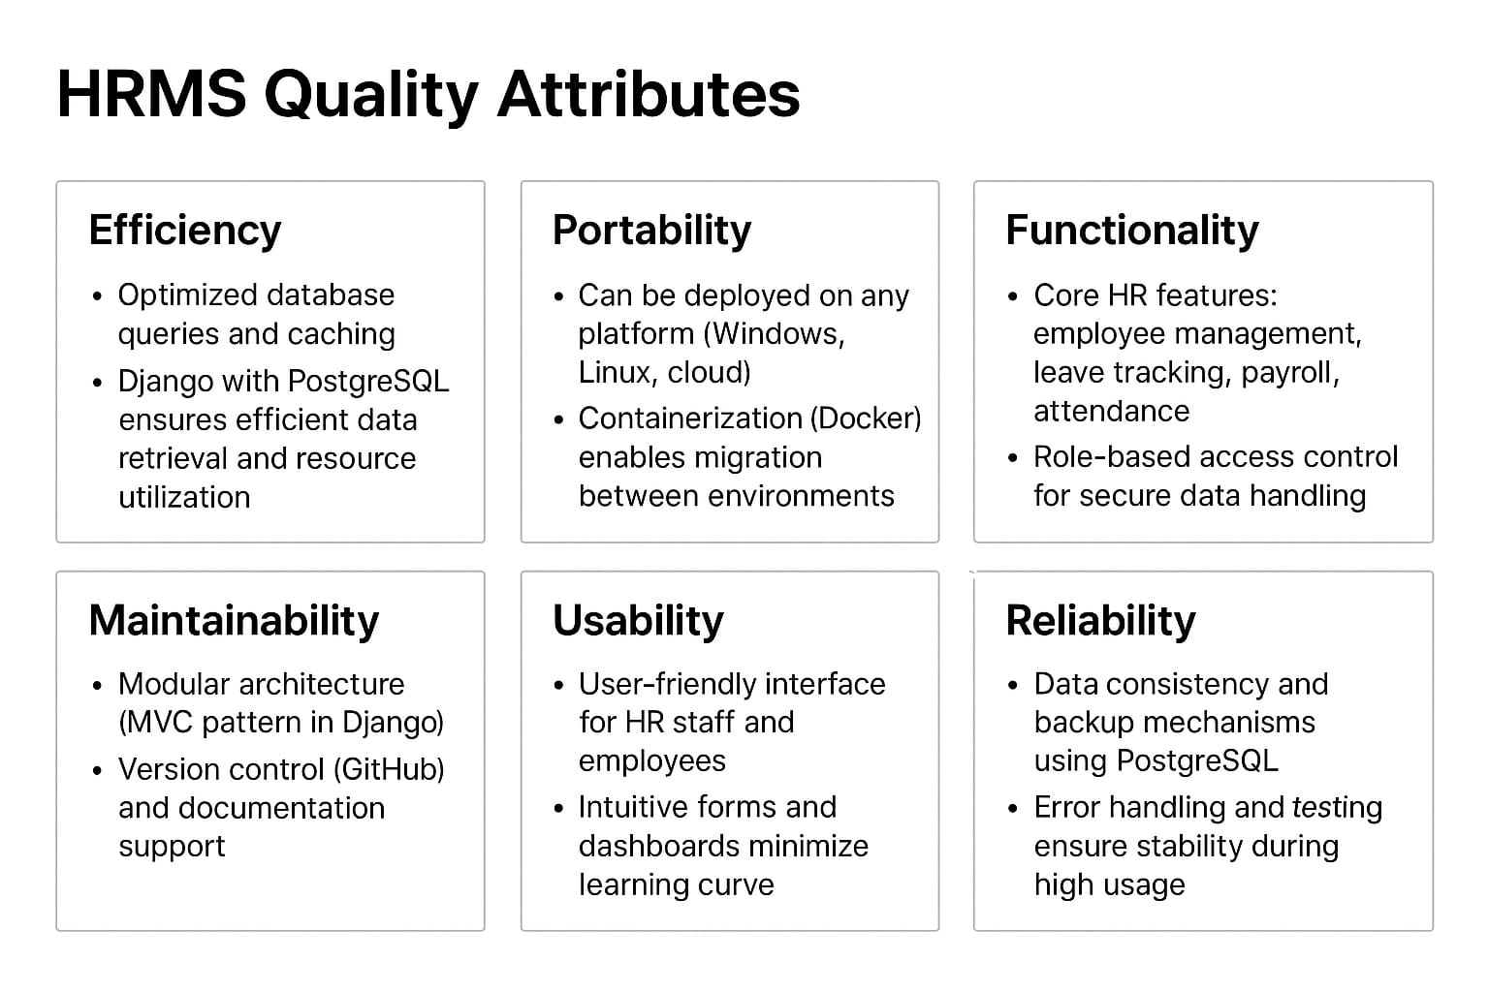

Slide 15
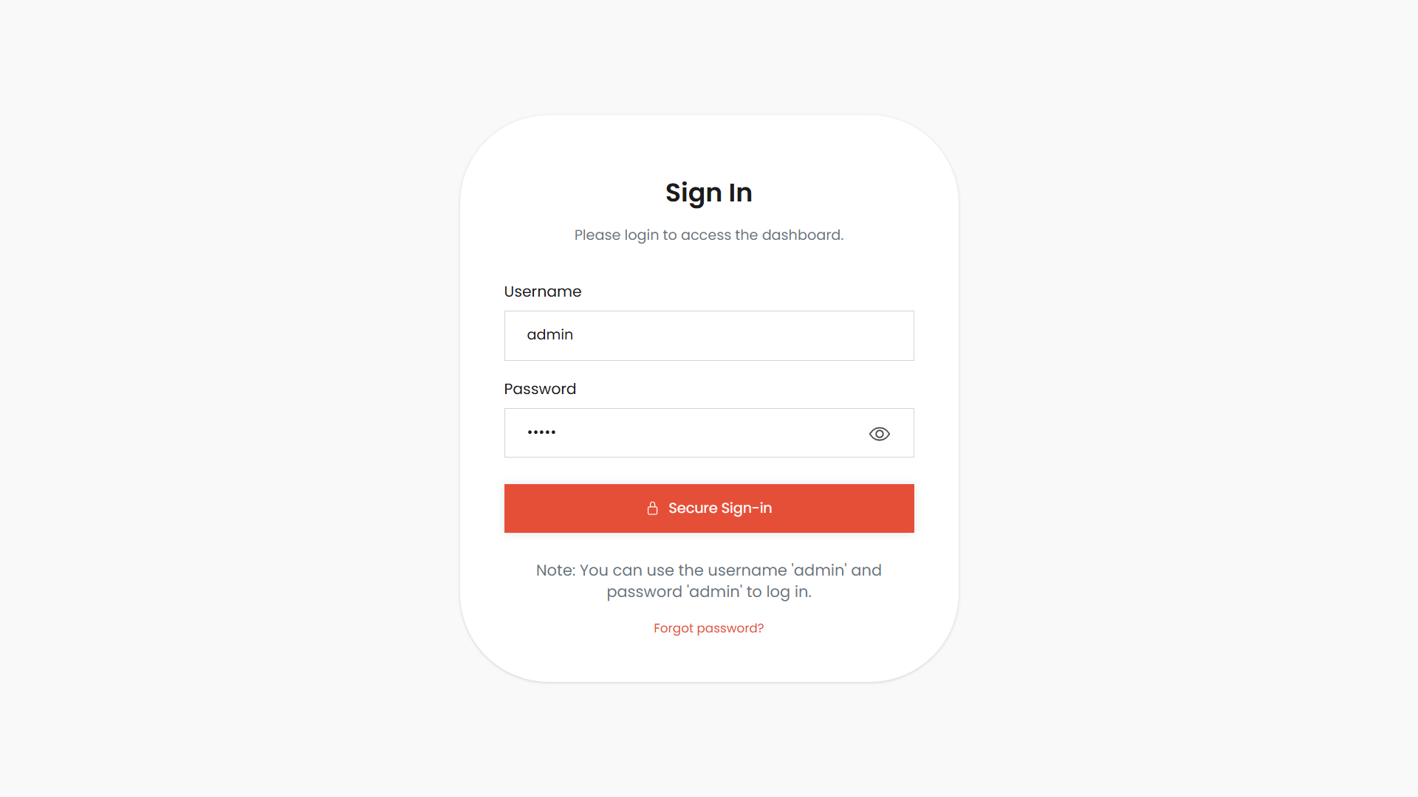

Slide 16
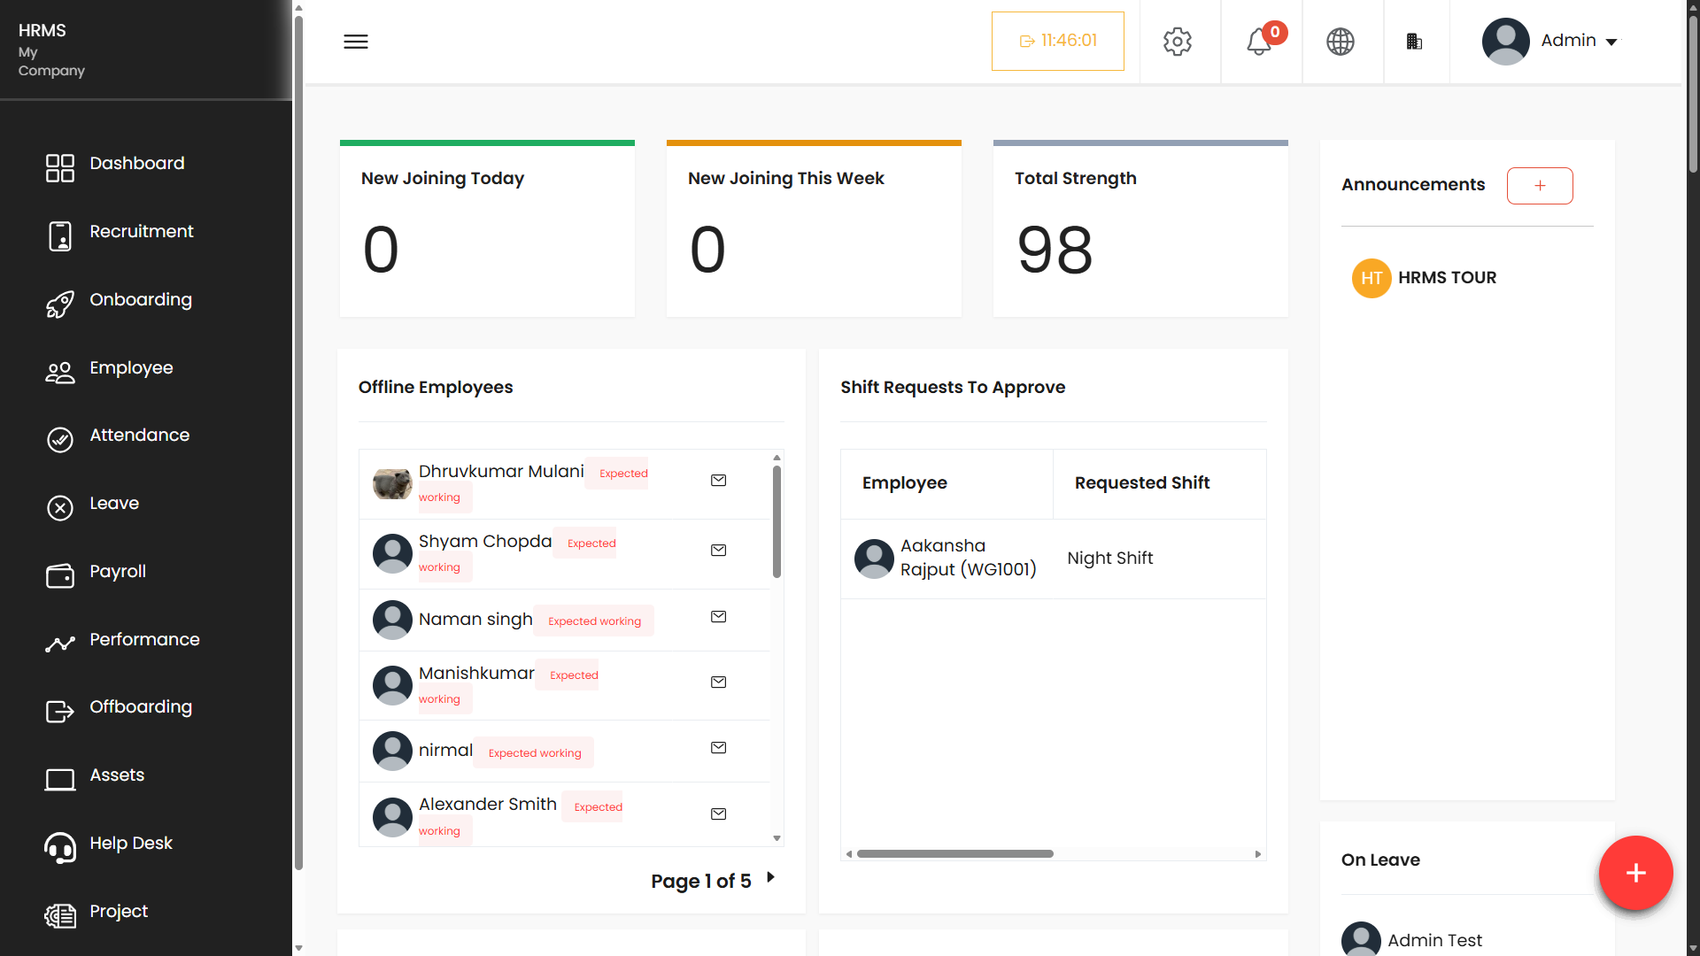

Slide 17
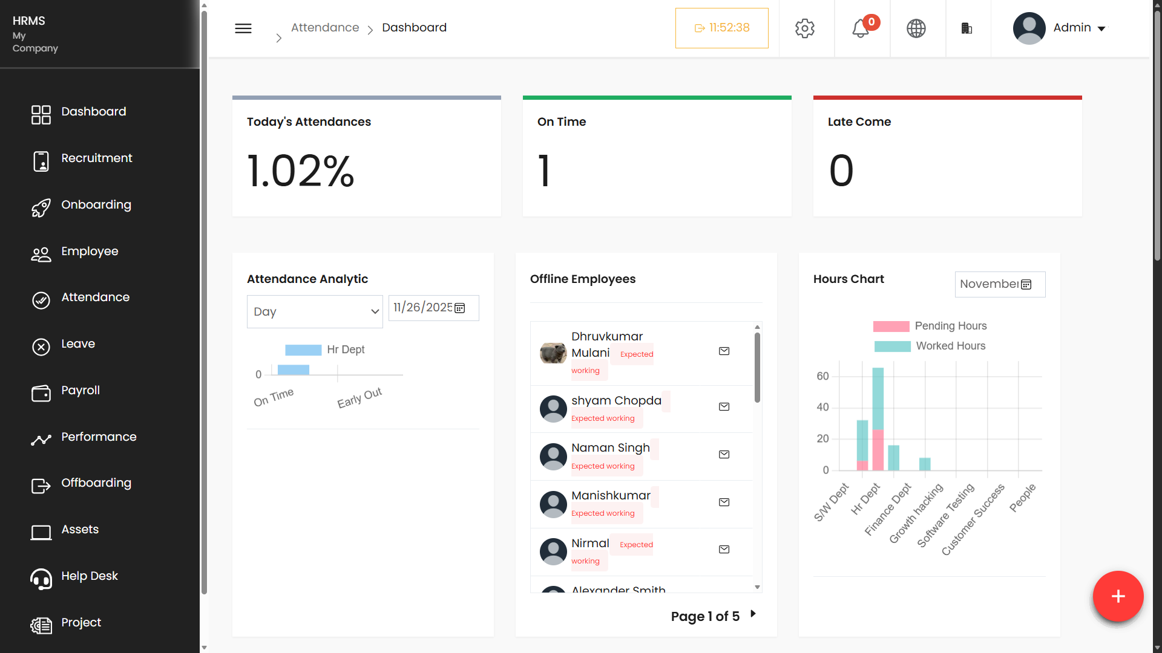

Slide 18
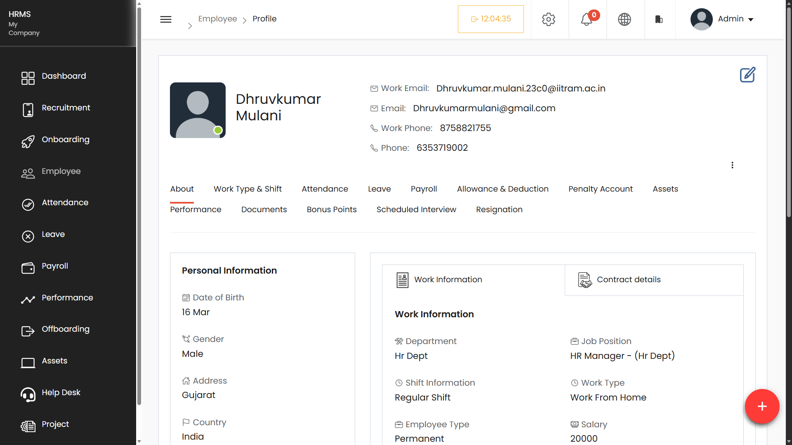

Slide 19
Thank You!...

